Slide 1

Python Level 2
Lesson 7: Two Problems

Slide 2
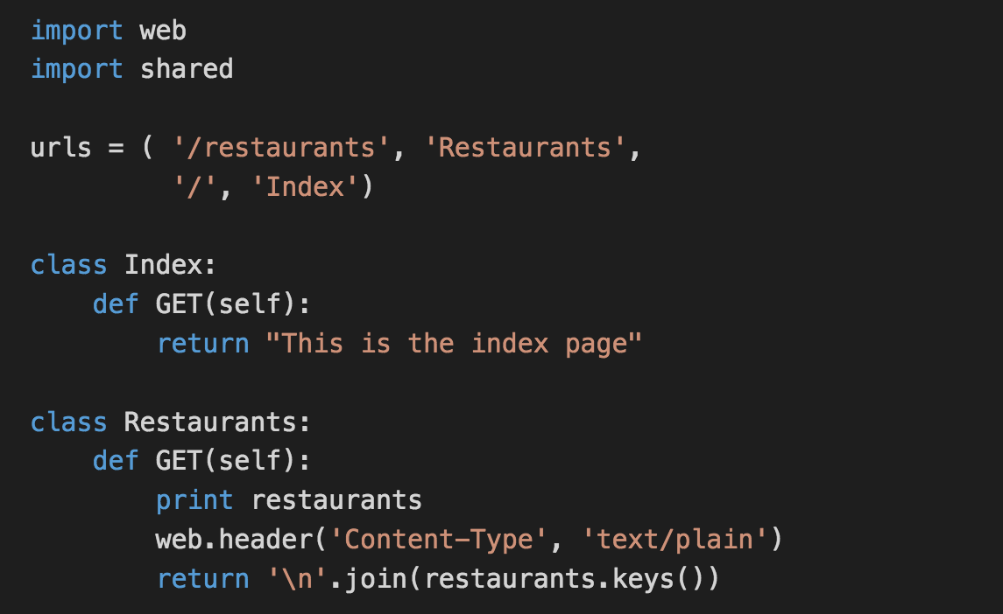

Last time
We beat our heads against Python 3.7 changes that broke the released version of web.py

Slide 3
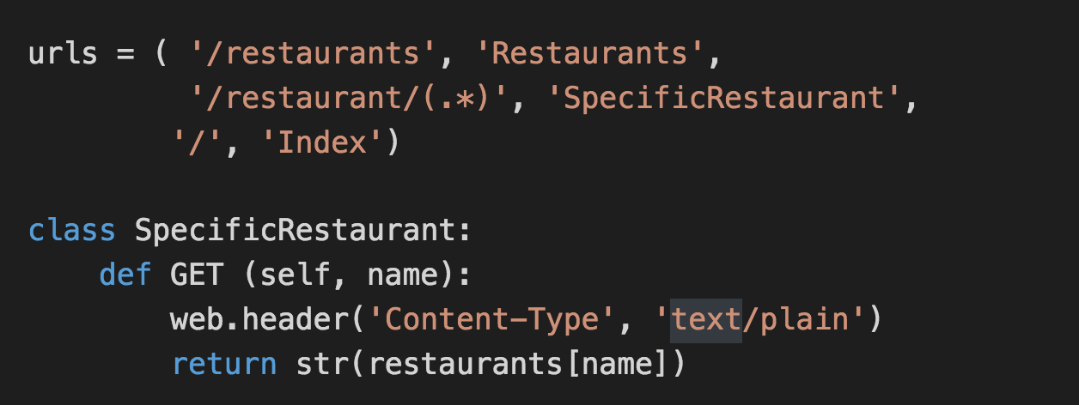
A Specific Restaurant?
Today’s code: http://eca-python/l2session7

Slide 4
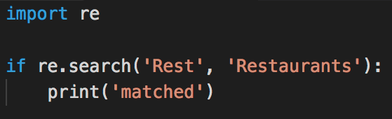
Regular Expressions
A way to match specific parts of a string
Common to almost all modern programming languages

Slide 5
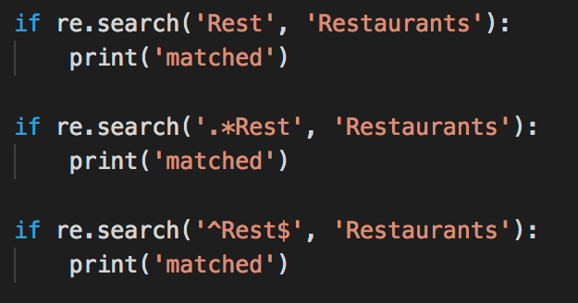
Regular Expressions (continued)

Slide 6

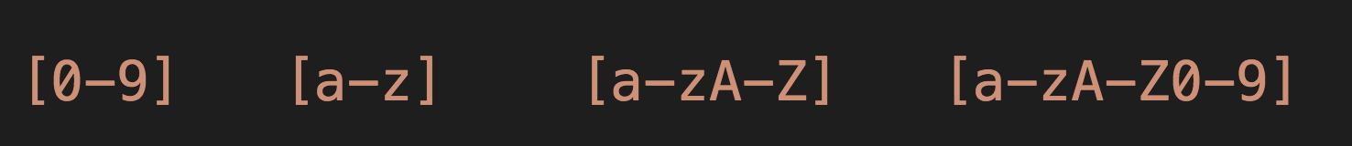
What about numbers?
Square brackets denote a match from a group of characters:

Slide 7
A lesson from history
Some people, when confronted with a problem, think:
“I know, I'll use regular expressions.”
Now they have two problems.
- Jamie Zawinski , 1997
Nightclub proprietor

Slide 8
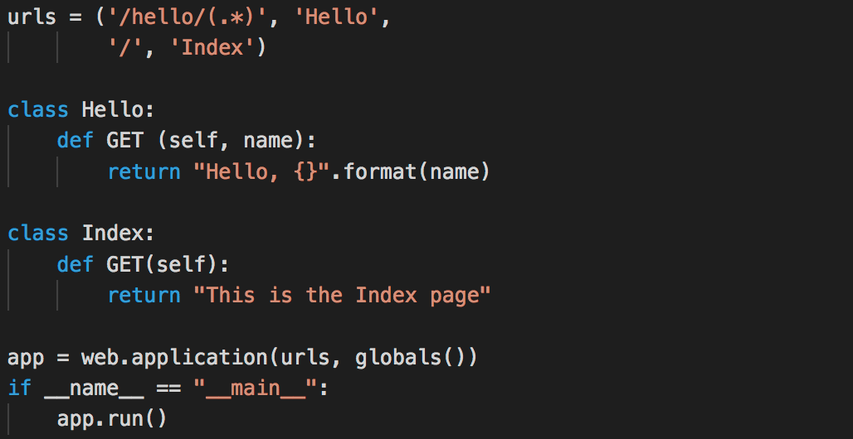
Saying “Hello!”

Slide 9
Back to our webserver
Modify your webserver code so that you can request all the restaurants that satisfy a given score, rating or distance:
For example:
http://127.0.0.1:8080/score/4 Lists all restaurants with a score of 4 or better

Slide 10
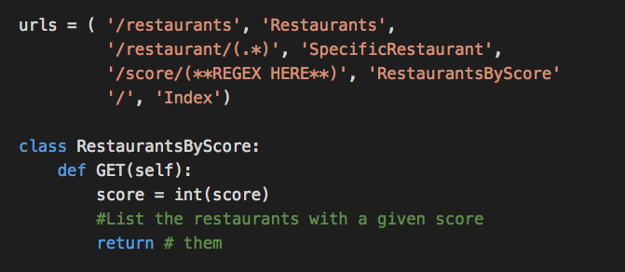
Back to our webserver

